Slide 1
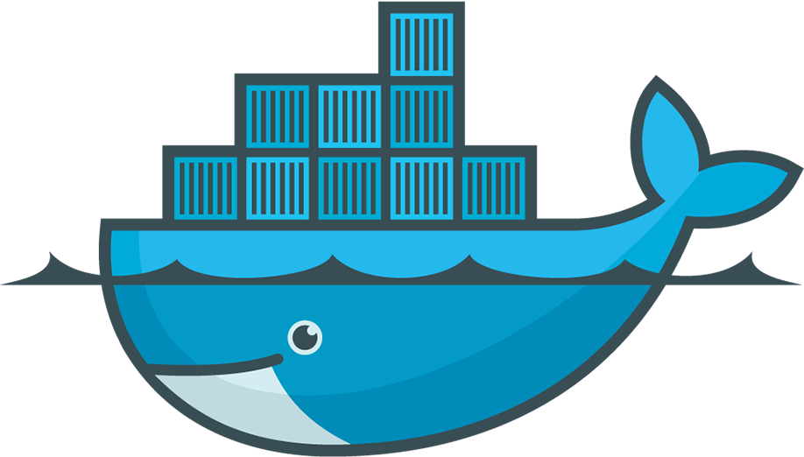
Docker Administration I
Chapter Four

Slide 2
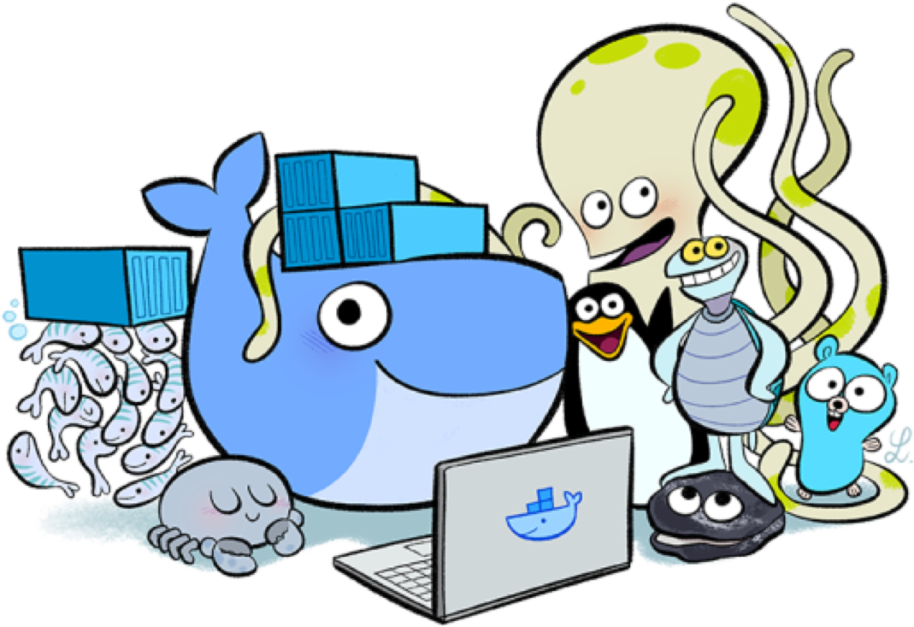
Objective
Install Docker Engine
Run Sample Application
Use Docker Compose

Slide 3




Install Docker Engine
Explain
Supported platforms:
Desktop:
Docker Desktop for Mac (MacOS)
Docker Desktop for Windows
Server:
CentOS
Debian
Fedora
Raspbian
RHEL
SLES
Ubuntu
Binaries
Other Linux distributions

Slide 4
Install Docker Engine
Explain
Release channels
The Stable channel gives you latest releases for general availability.
The Test channel gives pre-releases that are ready for testing before general availability (GA).
The Nightly channel gives you latest builds of work in progress for the next major release.
Reference: https://docs.docker.com/engine/install
Notes:
Stable
Year-month releases are made from a release branch diverged from the master branch. The branch is created with format <year>.<month>, for example 20.10. The year-month name indicates the earliest possible calendar month to expect the release to be generally available. All further patch releases are performed from that branch. For example, once v20.10.0 is released, all subsequent patch releases are built from the 20.10 branch.
Test
In preparation for a new year-month release, a branch is created from the master branch with format YY.mm when the milestones desired by Docker for the release have achieved feature-complete. Pre-releases such as betas and release candidates are conducted from their respective release branches. Patch releases and the corresponding pre-releases are performed from within the corresponding release branch.
Nightly
Nightly builds give you the latest builds of work in progress for the next major release. They are created once per day from the master branch with the version format: 0.0.0-YYYYmmddHHMMSS-abcdefabcdef
where the time is the commit time in UTC and the final suffix is the prefix of the commit hash, for example 0.0.0-20180720214833-f61e0f7.
These builds allow for testing from the latest code on the master branch. No qualifications or guarantees are made for the nightly builds.

Slide 5
Install Docker Engine
Explain
Install Docker Engine on RHEL (RHEL 7 & 8)
Uninstall old versions
Set up Docker’s repository
Install Docker Engine
$ sudo yum remove docker \
docker-client \
docker-client-latest \
docker-common \
docker-latest \
docker-latest-logrotate \
docker-logrotate \
docker-engine \
podman \
runc
$ sudo yum install -y yum-utils
$ sudo yum-config-manager \
--add-repo \
https://download.docker.com/linux/rhel/docker-ce.repo
1. Install the latest version of Docker Engine and containerd
$ sudo yum install docker-ce docker-ce-cli containerd.io
2. Start and Enable Docker service
$ sudo systemctl enable --now docker
3. Verify that Docker Engine is installed correctly
$ sudo docker run hello-world

Slide 6
Run Sample Application
Docker Run Command
Usage: docker run [options] image
Options:
-p / --publish : Publish a container's port(s) to the host
-v / --volume : Bind mount a volume
-h / --hostname : Container host name (optional)
-d / --detach : Run container in background and print container ID
Example: docker run –p 80:80 –h webapp-01 nginx:latest docker run –p 8080:80 –h webapp-02 nginx:latest docker run –p 8081:80 –v ./index.html:/usr/share/nginx/html/index.html –d nginx
Explain

Slide 7
Run Sample Application
Some useful troubleshoot commands:
Usage: docker [options] [command]
Options:
ps : List containers
image ls : List image
exec –it <container name/id> <cmd/shell> : Run a command in a running container
inspect <container name/id> : Return low-level information on Docker objects
stats : Display a live stream of container(s) resource usage statistics
rm <container name/id> : Remove one or more containers
rmi –f <image:tag/image id> : Remove one or more images
Explain

Slide 8
Run Sample Application
Explain
Clean-up commands:
docker system df : Show docker disk usage
docker system info : Display system-wide information
docker system events : Get real time events from the server
docker system prune : Remove unused data
docker image prune : Remove unused images
docker volume prune : Remove all unused local volumes
docker network prune : Remove all unused networks

Slide 9
Use Docker Compose
Explain
Compose is a tool for:
Defining and running multi-container Docker Applications
Using a YAML file to configure your application’s services
Single command to create and start all the services
Compose has commands for managing the whole life cycle of your application:
Start, Stop, and Rebuild services
View the status of running services
Stream the log output of running service
Run a one-off command on a service

Slide 10
Use Docker Compose
Explain
Check the compose release version here
Install compose on linux systems
Install compose on Windows Server
Install compose on Windows
Install compose on Mac
Install Compose reference: https://docs.docker.com/compose/install/
$ sudo curl -L "https://github.com/docker/compose/releases/download/1.29.2/docker-compose-$(uname -s)-$(uname -m)" -o /usr/local/bin/docker-compose
$ sudo chmod +x /usr/local/bin/docker-compose
$ docker-compose --version

Slide 11
Use Docker Compose
Docker Compose CLI
Usage: docker-compose [options] [commands]
Options:
-f / --file : Specify an alternate compose file (default: docker-compose.yml)
--verbose : Show more output
Commands:
up –d : Create and start containers in detached mode
down : Stop and remove resources
pull : Pull service images
restart : Restart services
logs [-ft] : View output from containers
ps : List containers
Explain

Slide 12
Use Docker Compose
Create Docker Compose YAML file
Note:
Compose file extension: .yaml or .yml
Default compose file name: docker-compose.yml/yaml
You can check the compose and docker compatibility matrix here
Compose file format and parameters:
version : Set compose version
services : Start defining your services configuration
image : Specify the image to start the container from
ports : Port mapping or expose ports with publishing to host machine
expose : Expose ports without publishing to host machine
volumes : Mount host paths or named volumes, specified as sub-options to a service
restart: [no, always, on-failure, unless-stopped] – restart policy after server reboot
Explain

Slide 13
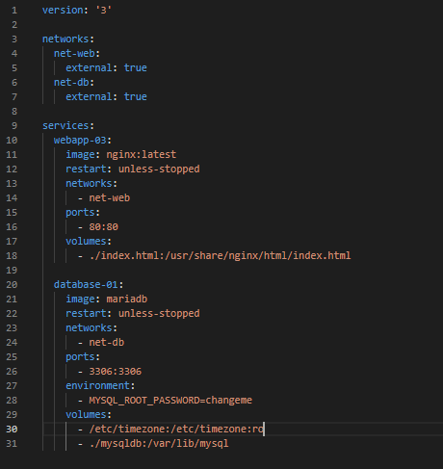
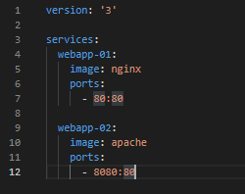
Use Docker Compose
Explain
Compose file sample:

Slide 14





Questioins
www.passerellesnumeriques.org

